Slide 1
Grading Non-JD Students with EasyNorm Lite

Slide 2
Complete Grading for JD Students
The first step is to complete your grading for all of your JD students using the standard EasyNorm provided to you by the Office of the Registrar.
Once you’ve completed your JD grading, keep the JD EasyNorm file open as you will be referring to it for the first couple of steps for EasyNorm Lite.

Slide 3
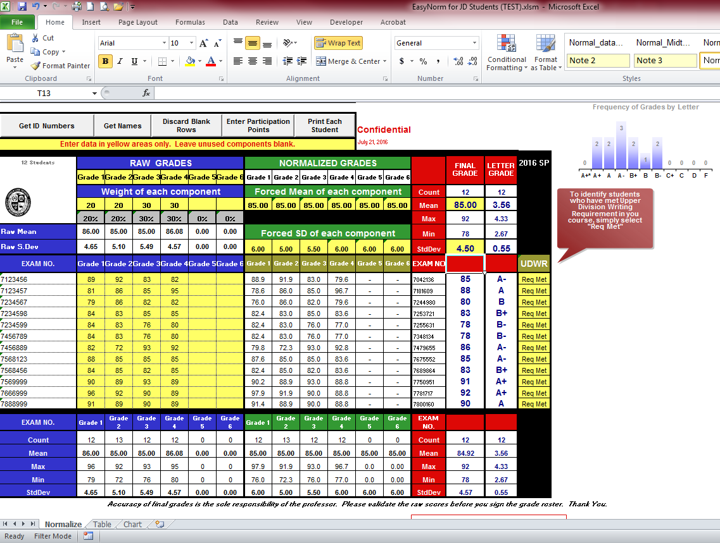
Complete Grading for JD Students

Slide 4
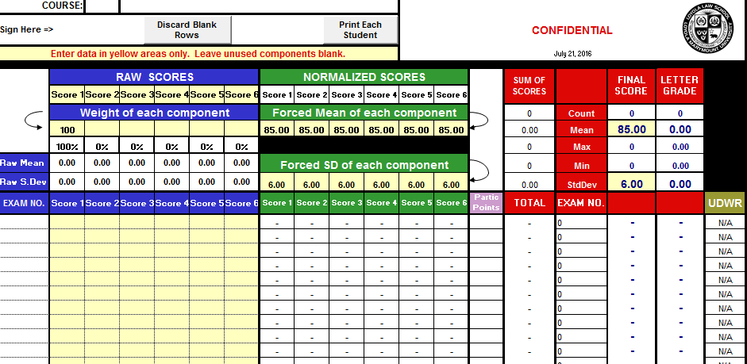
Open EasyNorm Lite
Now that you have completed your grading for JD students, you can now open EasyNorm Lite.

Slide 5
Copy Student Info and Scores
Select all of the student info and scores by highlighting all of the cells from the first name/student ID from your JD Easynorm through the last score of your last student.
Copy the data by pressing Ctrl+C or hitting the
button on the top menu.

Slide 6
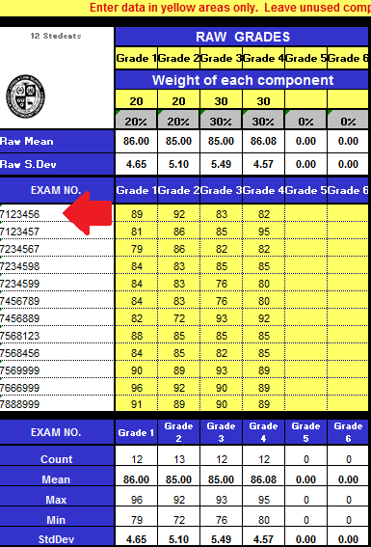
Copy Student Info and Scores

Slide 7
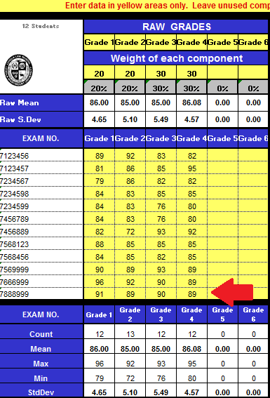
Copy Student Info and Scores

Slide 8
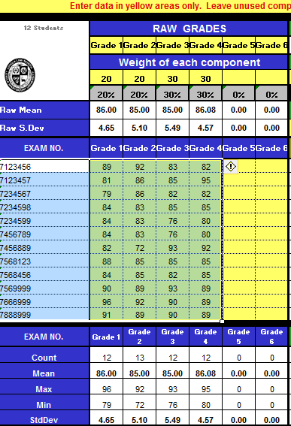
Copy Student Info and Scores

Slide 9
Paste Student Info and Scores
Now paste the data into EasyNorm Lite.
Select the first cell on the far left in the column labeled ‘EXAM NO’.
Press Ctrl+V or hit the button on the top menu.

Slide 10
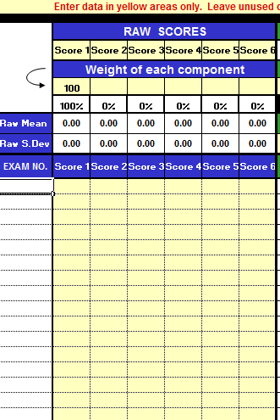
Paste Student Info and Scores

Slide 11
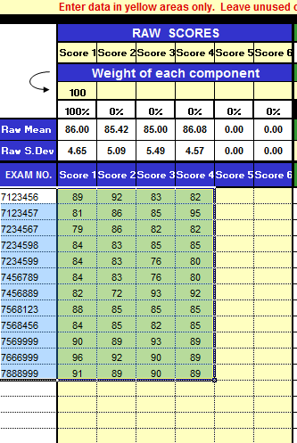
Paste Student Info and Scores

Slide 12
Input Weights & Mean / Std Dev
Transfer over the weights of your components, as well as any changes to the mean and standard deviation of your individual components or the mean and standard deviation of your final scores, from your JD EasyNorm file to your EasyNorm Lite file.

Slide 13
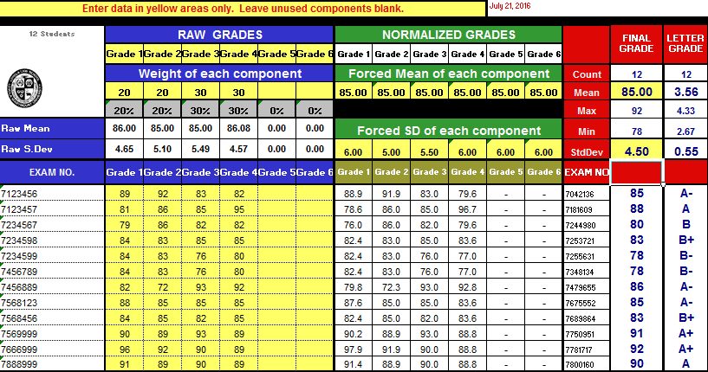
Input Weights & Mean / Std Dev

Slide 14
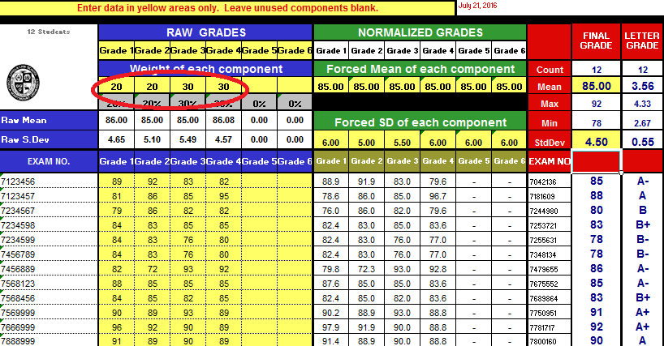
Input Weights & Mean / Std Dev

Slide 15
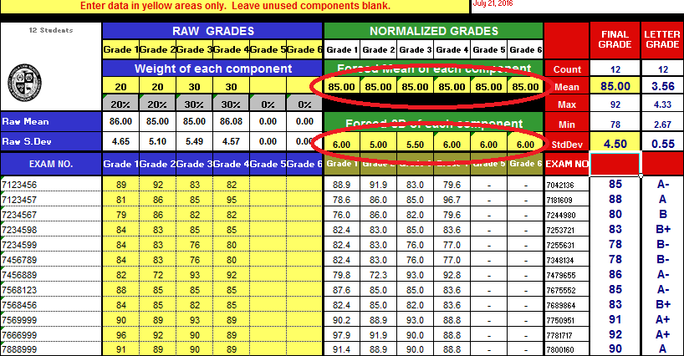
Input Weights & Mean / Std Dev

Slide 16
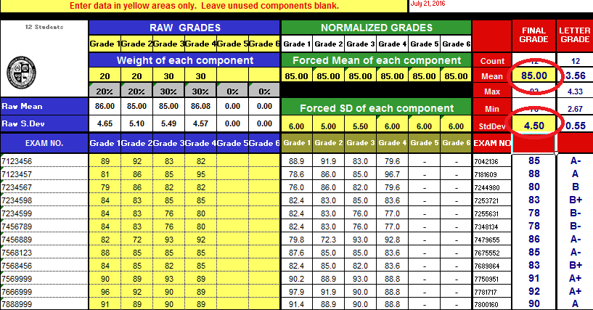
Input Weights & Mean / Std Dev

Slide 17
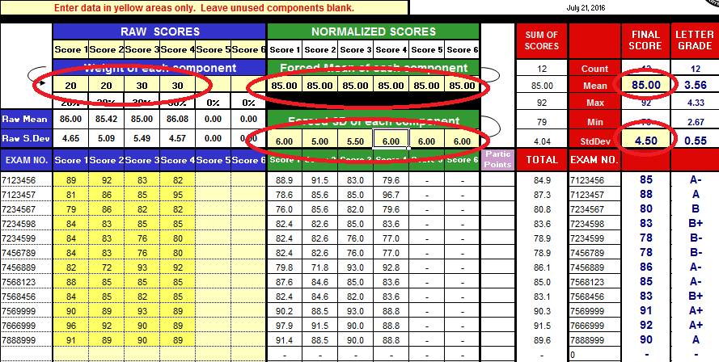
Input Weights & Mean / Std Dev
Input these into your EasyNorm Lite

Slide 18
Input Non-JD Student Data
You should now have an exact copy of your JD grades that you can use to determine where your non-JD student(s) would have fallen had they been graded on the same curve as the JD students.
Final scores on your EasyNorm Lite may differ if you have entered participation points on your JD EasyNorm. Participation points are calculated in the background and are not shown to preserve anonymity.
Input the data on the next line after your last JD student on your EasyNorm Lite.
You can input anything on the first column (e.g. name, student ID, or even a nickname like “NonJD student 1, etc.).

Slide 19
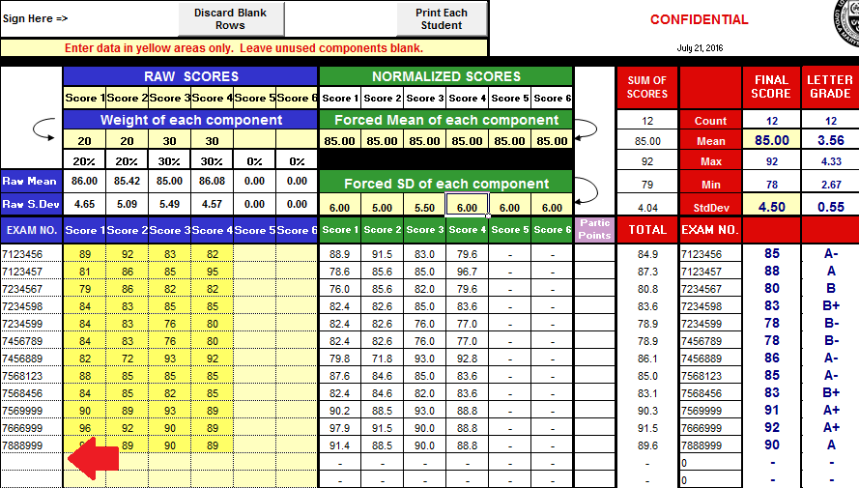
Input Non-JD Student Data

Slide 20
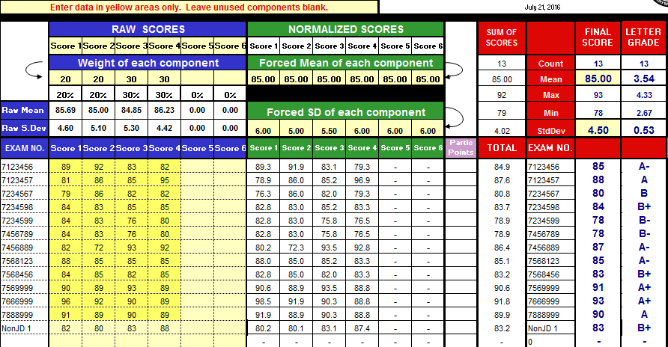
Input Non-JD Student Data

Slide 21
Input Non-JD Student Data
From the example shown, you can see that the non-JD student would have received a B+ had they been graded on the same curve as the JD students.
You can now follow the guidelines from the non-JD grading memo to determine what final grade to assign your non-JD students.
http://www.lls.edu/site/officeoftheregistrar/grading/

